Slide 1
PGST Meeting 5/15
Port Gamble S'Klallam Tribe Energy Analysis and Decarbonization
UW ChemE Capstone Team

Slide 2
Today's Agenda
Final Campus-Wide Survey
Boiler Replacement Design Rationale and REopt Configurations
Key Findings
Next Steps

Slide 3
Final Campus-Wide Survey
GHG Emissions
Propane Usage
New Electric Demand
Amount of electricity demand associated with new equipment
Solar Capacity
Roof space available for solar installation
Annual MWh
Amount of solar energy generated per year
Net Annual Savings
Cost reduction associated with new equipment and solar installation

Slide 4
Final Campus-Wide Survey (cont.)
Propane BAU and increased electric demand
GHG Emissions
Propane Usage
New Electric Demand
Solar and potential savings
Solar Capacity and Annual MWh
Note: Buildings 10 and 11 can be combined due to their continuous roof line.
Net Annual Savings

Slide 5
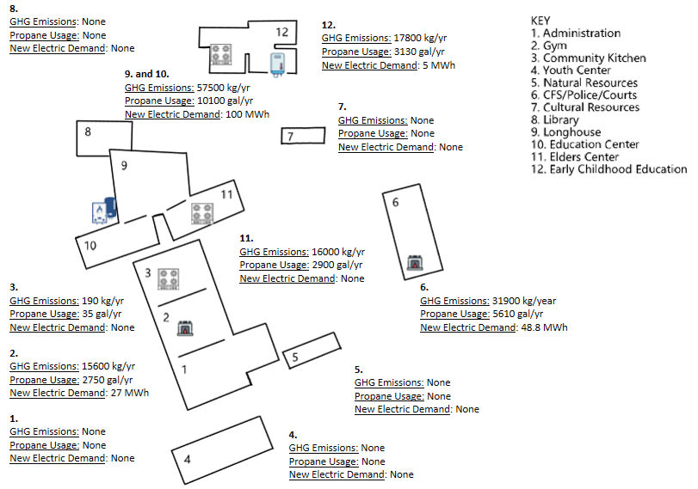
Propane and Electricity

Slide 6
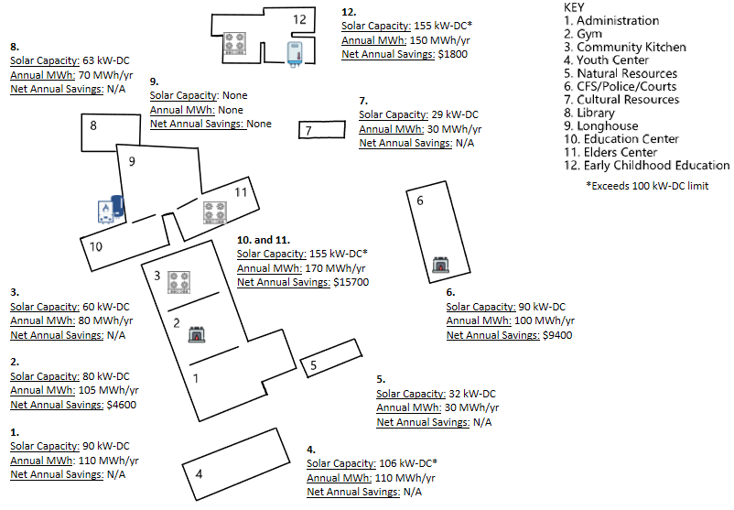
Solar and Savings

Slide 7
Boiler Replacement Design Rationale
We will model combinations of the following to evaluate the economic impact upfront and over time.
Heating system: Electric boiler (simpler, higher operating cost) vs. air-source heat pump (more efficient, higher upfront cost)
Solar + compensation: Whether to add rooftop PV, and whether PSE credits it at net metering or net billing rates
Battery storage: Whether behind-the-meter storage makes financial sense under Schedule 25 demand charges
⇒ The next slide shows the full scenario matrix

Slide 8
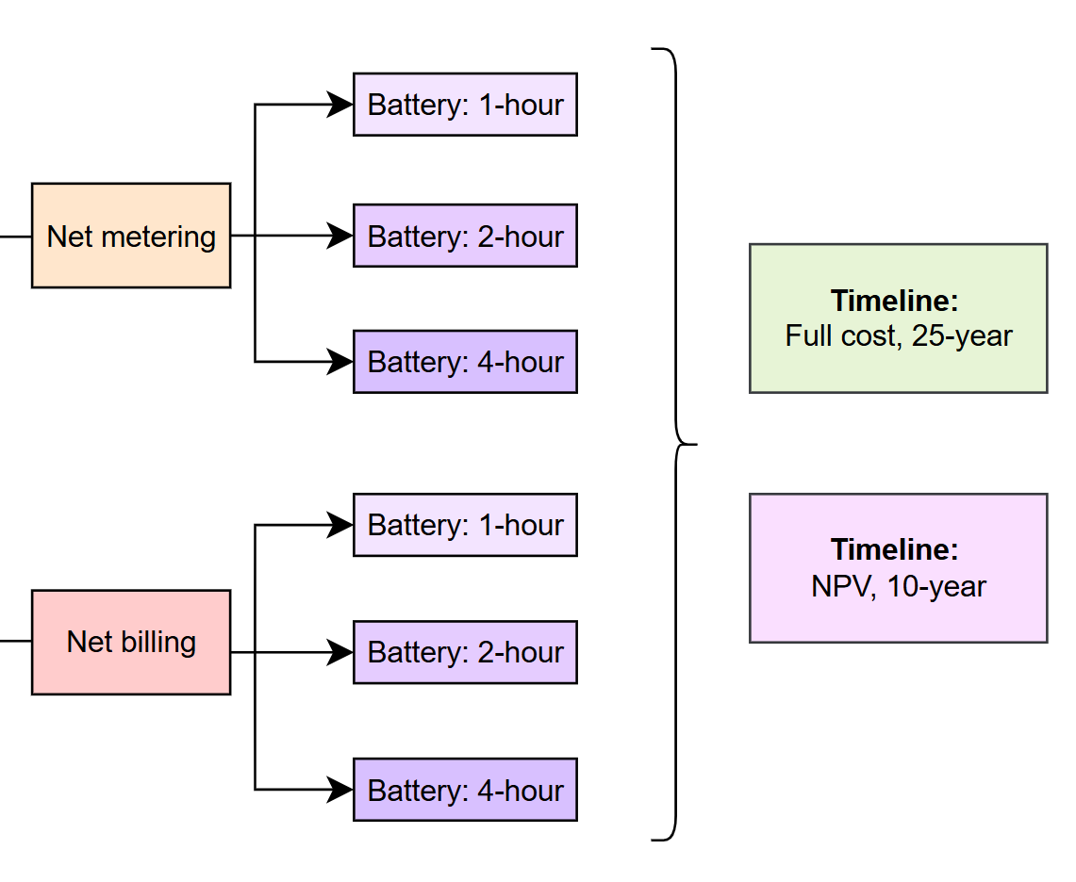
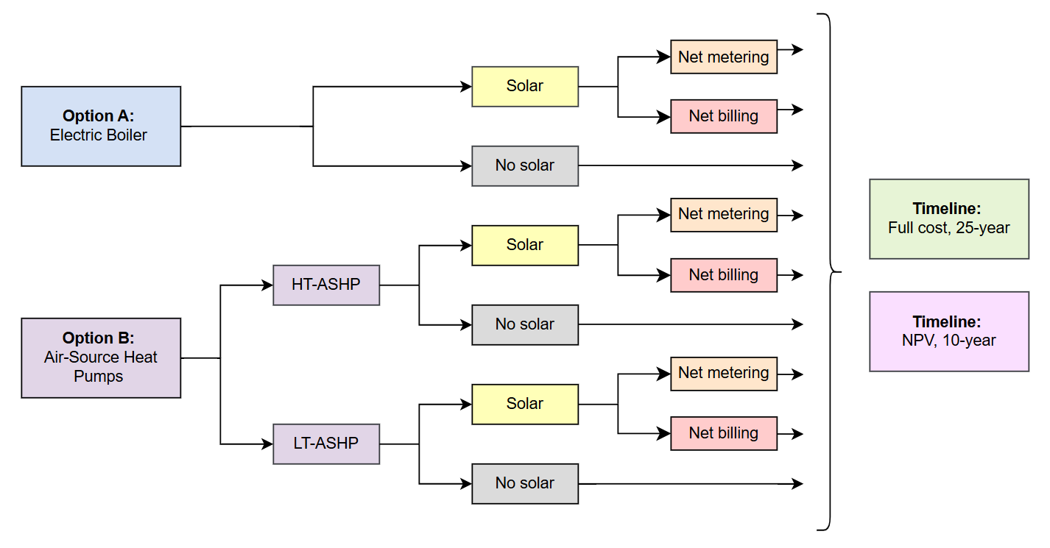
REopt Design Configurations
Scenarios without battery
Sch 25
Scenarios with battery
Sch 25
Other options considered - hybrid heating system
Sch 24 & 25

Slide 9
Scenarios without battery
Sch 25
Scenarios with battery
Sch 25
Sch 24 & 25

Slide 10
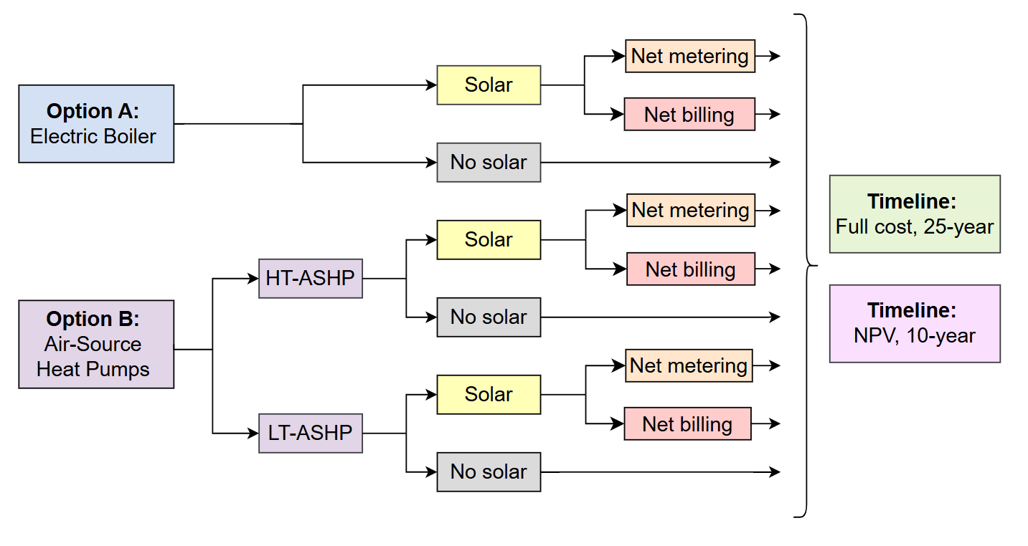
Scenarios without battery
Sch 25
Scenarios with battery
Sch 25
Sch 24 & 25

Slide 11

REopt Simulation Progress
Scenarios without battery
Scenarios with battery:
Electric boiler
LT-ASHP
HT-ASHP
Sch 25

Slide 12
Financial Inputs and Comparison Metrics
Financial Inputs:
Net billing vs. net metering: water treatment plant vs. clinic (and long-term availability of PSE rate structures)
Two financial lenses:
Full cost (25-year): includes upfront capital costs
NPV savings (10-year): if capital costs paid
Outputs for comparison analysis
Optimized PV/ASHP size and coverage: system design
Costs (Year 1 and annual) compared to baseline: feasibility
Emissions from eliminating propane

Slide 13
Key Findings: Net Metering vs. Net Billing
An 80 kW solar array covering CEC/EC buildings would produce ~62,000 kWh annually. For the LT heat pump scenario, ~34,000 kWh would be exported to the grid.
Net metering export credits: ~$5,000 annually
Net billing export credits: ~$2,300 annually
The same pattern holds across HT heat pump and electric boiler scenarios.
Recommendation: if option is given, select net metering
(subject to PSE eligibility/approval)

Slide 14
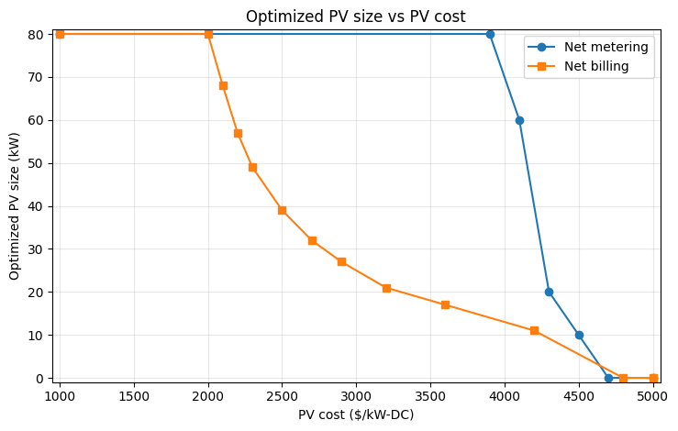
Key Findings: PV
Net metering: Because exports are credited near the retail rate, PV stays attractive up to a tipping point (~$4,000/kW-DC)
Net billing: Because exports are paid at a lower sell rate, the optimal system size declines more gradually with increasing installed cost.
Recommendation: PV recommended on CEC/EC roofs to offset increased electricity demand from electrification

Slide 15
Key Findings: Battery
At full cost, battery storage is not financially viable
Modeled scenarios consistently show that value from demand charge savings and exports cannot outweigh upfront and replacement costs.
However, with grant funding, a battery can deliver net value to the Tribe.
*for electric boiler scenario
Note: Under net billing, storing excess solar for later use (~$0.11/kWh benefit) beats exporting it at the low credit rate (~$0.07/kWh). Under net metering, exports are credited at the full retail rate, so value of battery comes solely from lowering demand charges.
Compensation type | Battery Size | Required Grant Size | NPV (10 year payback period)
Net billing | 50 kWh / 100 kWh | ~$80,000 | ~$22,000*
Net metering | 50 kWh / 100 kWh | ~$80,000 | ~$10,000*

Slide 16
Next Steps
Finalize heating system cost comparison
Electric boiler vs. Heat pumps
Complete battery storage analysis
June 4 — UW Clean Energy Institute Community Capstone Showcase at McKinstry's offices in Seattle
June 15 — Final report delivered to PGST

Slide 17
Thank you!

Slide 18
Example Scenario
Electric Boiler with Solar, net metering, no battery, full cost
Select technologies: PV and ASHP
ASHP used to model electric boiler
Selected net metering or specified net billing (~$0.06/kWh)
Uploaded existing electricity and thermal load profiles (estimated from previous propane allocation)
Specify capital costs: propane boiler, ASHP section (electric boiler)
Change REopt inputs according to scenario pathway.

Slide 19
Simulation Scope: REopt priorities
High priority
Full hydronic system replacement
Electric boiler vs. LT HP vs. HT HP
PV, economic and environmental impact
Battery systems, benefits
Compensation type, economic impact
⇒ Our comprehensive report on replacement pathways will inform PGST on how to handle their largest propane consumer.
Notes:
Remove slide. Go straight to “here is what we are doing”
Only we believe we are reducing the scope - Rachel didn’t think this as far as we can tell (just get Rachel ready for what we are seeing in final report, don’t present this like we are renegotiating the contract). Rachel will be blown away by what we are going to do - she won’t perceive that we are doing less. We will be doing more than she expects if we deliver what we are promising.

Slide 20
Simulation Scope: REopt priorities
Medium priority
Hybrid system replacement study
CFS furnace replacement simulations
Lower priority
Replacement recommendations for:
Gym furnace
DHW
Stoves
⇒ These recommendations either require less simulations or have straightforward, drop-in solutions (no simulation req.)
Notes:
Remove slide. Go straight to “here is what we are doing”
Only we believe we are reducing the scope - Rachel didn’t think this as far as we can tell (just get Rachel ready for what we are seeing in final report, don’t present this like we are renegotiating the contract). Rachel will be blown away by what we are going to do - she won’t perceive that we are doing less. We will be doing more than she expects if we deliver what we are promising.

